Slide 1
Cross Validation

Slide 2
What is Cross-Validation?
One of the key topics around testing your learning models.
Technique used in machine learning to evaluate the performance of a model on unseen data.
Involves dividing the available data into multiple folds or subsets, using one of these folds as a validation set, and training the model on the remaining folds
Cross validation is an important step in the machine learning process and helps to ensure that the model selected for deployment is robust and generalizes well to new data.

Slide 3
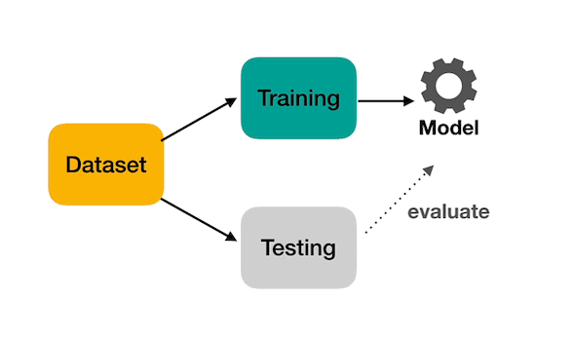
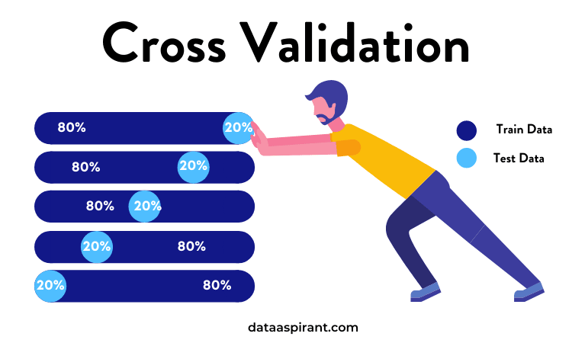
What is Cross-Validation?

Slide 4
The main goal of Cross-Validation
The main purpose of cross validation is to prevent overfitting
By evaluating the model on multiple validation sets, cross validation provides a more realistic estimate of the model’s generalization performance.

Slide 5
Types of Cross-Validation
K-Fold Cross-Validation.
Leave-one-out Cross-Validation.
Holdout validation.
Stratified Cross-Validation.
The choice of technique depends on the size and nature of the data

Slide 6
1- K-Fold Cross Validation
In K-Fold Cross Validation, we split the dataset into k number of subsets (known as folds)
Then we perform training on the all the subsets but leave one(k-1) subset for the evaluation of the trained model.
In this method, we iterate k times with a different subset reserved for testing purpose each time.

Slide 7
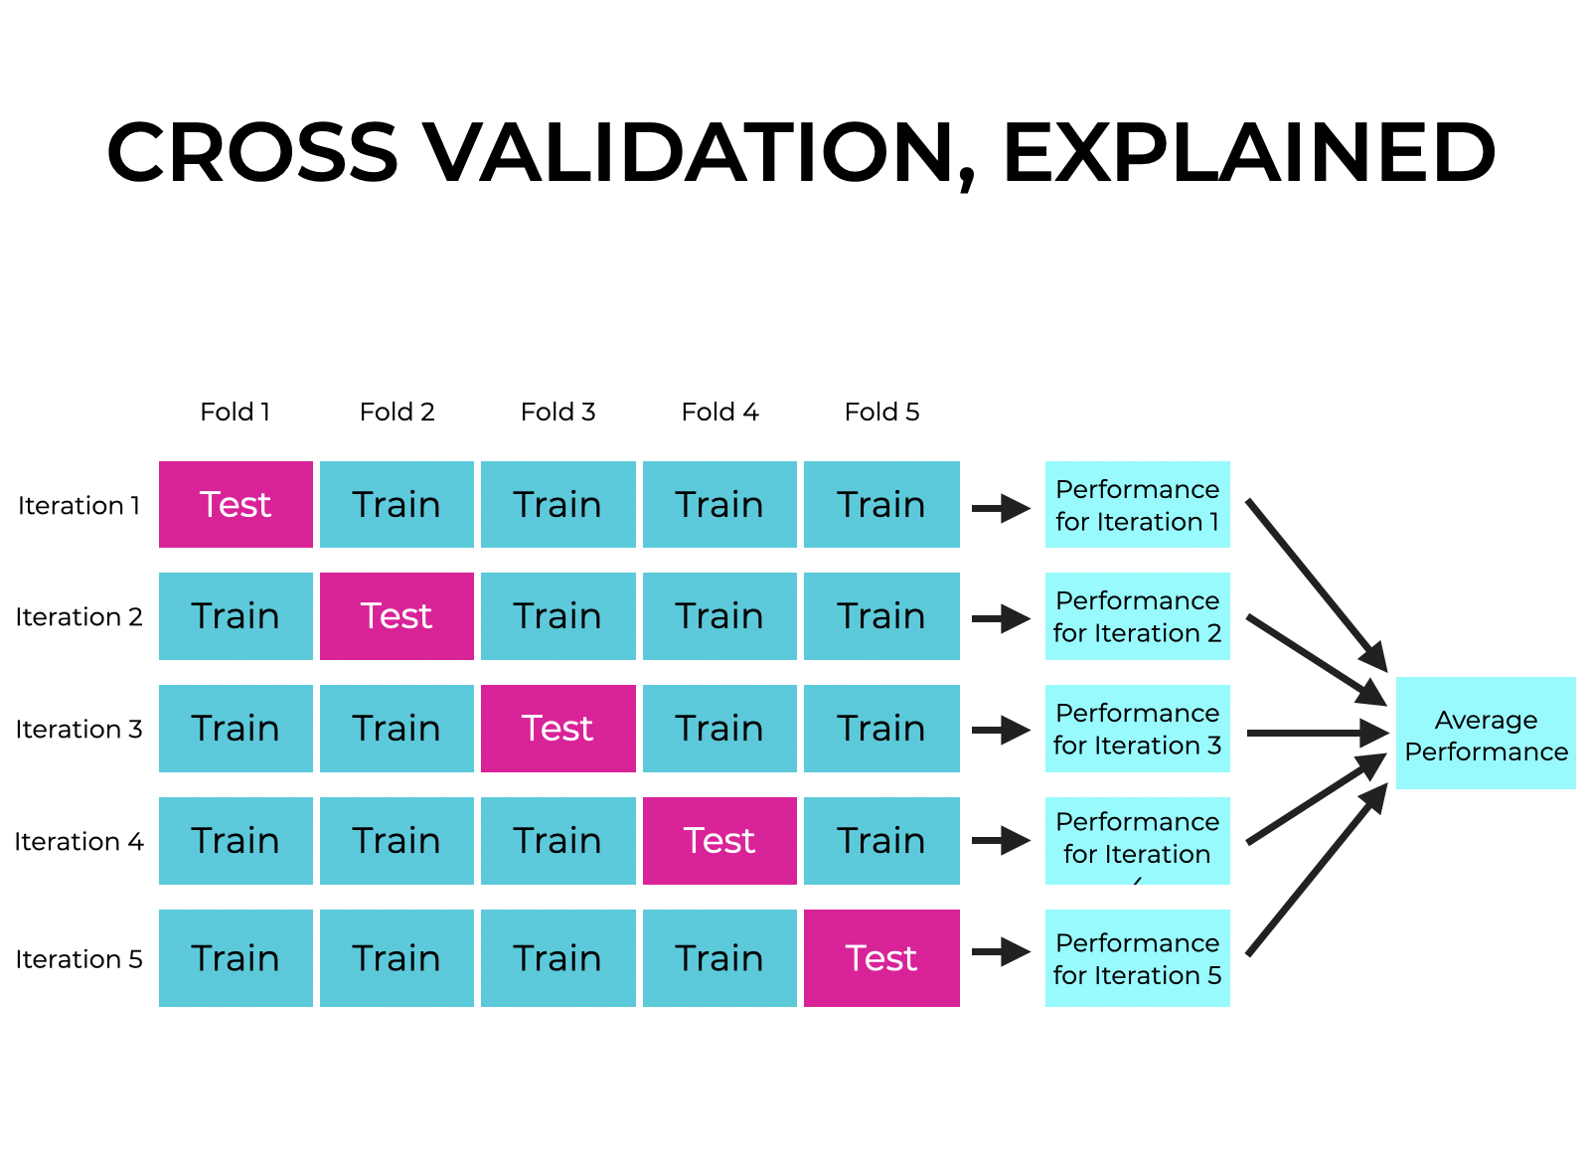
1- K-Fold Cross Validation

Slide 8
2-Leave-one-out Cross-Validation(LOOCV)
In this method, we perform training on the whole dataset but leaves only one data-point of the available dataset and then iterates for each data-point.
The model is trained on n-1 samples and tested on the one omitted sample, repeating this process for each data point in the dataset.
Pros: we make use of all data points and hence it is low bias.
Cons:
It leads to higher variation in the testing model as we are testing against one data point.
If the data point is an outlier it can lead to higher variation
it takes a lot of execution time

Slide 9
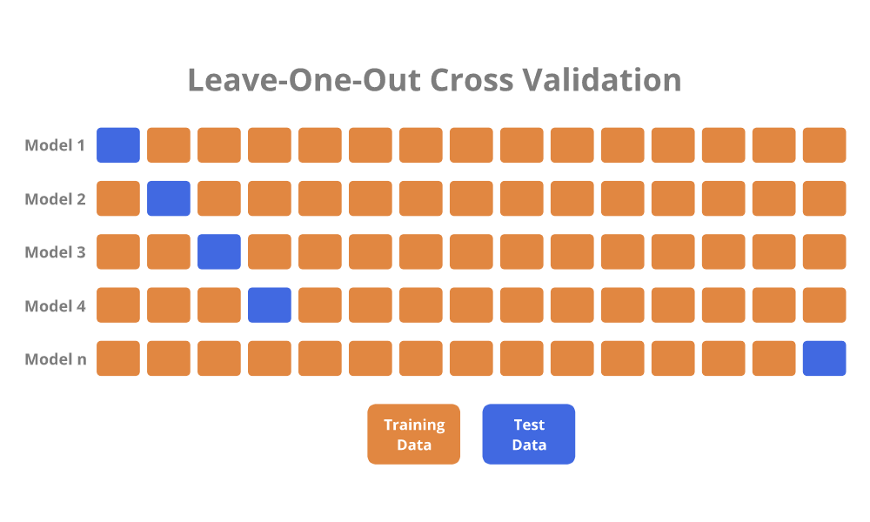
2-Leave-one-out Cross-Validation(LOOCV)

Slide 10
3-Holdout validation.
We perform training on the 50% of the given dataset and rest 50% is used for the testing purpose.
Pros:
It’s a simple and quick way to evaluate a model.
Cons:
we perform training on the 50% of the dataset, it may possible that the remaining 50% of the data contains some important information.

Slide 11
4-Stratified Cross-Validation
It is a technique used in machine learning to ensure that each fold of the cross-validation process maintains the same class distribution as the entire dataset.
This is particularly important when dealing with imbalanced datasets.
In this method:
The dataset is divided into k folds while maintaining the proportion of classes in each fold.
During each iteration, one-fold is used for testing, and the remaining folds are used for training.
The process is repeated k times, with each fold serving as the test set exactly once.
Is essential when dealing with classification problems.

Slide 12
Advantages of Cross Validation
Overcoming Overfitting:
Cross validation helps to prevent overfitting by providing a more robust estimate of the model’s performance on unseen data.
Model Selection:
Cross validation can be used to compare different models and select the one that performs the best on average.
Hyperparameter tuning:
Cross validation can be used to optimize the hyperparameters of a model, such as the regularization parameter, by selecting the values that result in the best performance on the validation set.
Data Efficient:
Cross validation allows the use of all the available data for both training and validation, making it a more data-efficient method compared to traditional validation techniques.

Slide 13
Disadvantages of Cross Validation
Computationally Expensive:
Cross validation can be computationally expensive, especially when the number of folds is large or when the model is complex and requires a long time to train.
Time-Consuming:
Cross validation can be time-consuming, especially when there are many hyperparameters to tune or when multiple models need to be compared.
Bias-Variance Tradeoff:
The choice of the number of folds in cross validation can impact the bias-variance tradeoff, i.e., too few folds may result in high variance, while too many folds may result in high bias.

